Slide 1

ARCHITECTURAL ENHANCEMENTS
Bitcoin Core
Pereira D, Susilo A, Shrestha K
Bridson-Boyczuk A, Fung C, Wuthrich I
CISC 322 W22 Professor Bram Adams
12/04/2023

Slide 2
Team FTX
Devin Pereira
Alex Susilo
Kanchan Shrestha
Cyrus Fung
Adlai Bridson-Boyczuk
Isaiah Wuthrich
01
02
Presenter
Approach 1
Conclusion
Impact on Subsystems (App, Util)
Impact on Concrete Arch. (App, Util)
Lessons Learned
Presentation Aesthetics
03
04
Team Lead
Use Cases/Diagrams
Impact on Subsystems (Wallet, Mining)
Impact on Concrete Arch. (Wallet, Mining)
Approach 2
Connection Manager
Security
Testing
05
06
Presenter
Introduction
Abstract
SEI SAAM Analysis
Overview of New Feature
Impact on Subsystems (Storage Engine)
Impact on Concrete Arch. (Storage Engine)

Slide 3
Introduction
Proposal of new feature
Implementation approaches to consider
Impact on current subsystems
Risks and Limitations
Testing strategy
Use Cases
Conclusion
and Lessons Learned

Slide 4
OVERVIEW OF NEW FEATURE
WHAT IS THE NEW FEATURE?
WHAT IMPACT WILL IT HAVE?
Users can view the Exchange Rate
Users can set their Trading Rate
All in App!
Simplifies and streamlines buying and selling
Facilitates wider adoption of Cryptocurrency

Slide 5
Approach 1
GUI
Storage Engine:
Set Rate
New
Subcomponent
Rates
Peers

Slide 6
Approach 2
MARKET
DATA SOURCE
MARKET
DATA SOURCE
Users set their own data sources (typically from cryptocurrency exchanges)
No peer-to-peer communication

Slide 7
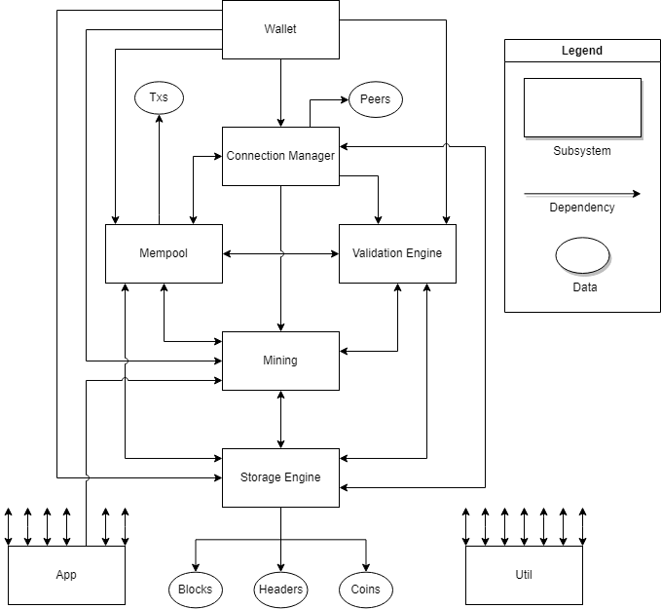
Concrete Architecture

Slide 8
SEI SAAM Analysis 1
Stakeholders
Bitcoin Core Developers
Bitcoin Network Users
Miners, Exchanges and Wallet providers
Merchants
General Users
and Financial Institutions

Slide 9
SEI SAAM Analysis 1.2
NFRs
Developers: Reliability, Scalability, Maintainability
Miners: Accuracy, Performance
Preferred approach: client-server (approach 2)
General Users & Financial Institutions: Compliance, Security, Accuracy, Ease of Use
Preferred approach: client-server (approach 2)

Slide 10
SEI SAAM Analysis 2
Architecture Choice: Peer-to-Peer (approach 1)
Scalability: Allows for easy addition of new nodes to handle increasing data and user requests
Reliability: The Distributed nature of the architecture reduces the risk of failure at a single point
Ease of integration: This architecture is easy to integrate with existing systems and applications
User Control: Enables direct communication between nodes, providing users with more control over exchange rates
Maintainability, Testability, Evolvability, and Performance of overall architecture

Slide 11
Impact of New Addition

Slide 12
Storage Engine
Impact on Subsystem
New subcomponent called Rates
Rates stores Exchange and Trading rates
Impact on Concrete Architecture
New files containing rates in “Rates” folder
Rates can be:
Set by the user in App
Received by other nodes via Connection Manager

Slide 13
Connection Manager
Impact on subsystem
Impact on concrete architecture
Additional connection to Rates
Pub-sub style where rate updates are events
No additional connections to handle case where node is sending/receiving data from peers
Add dedicated submodule called Market Data Manager
Configuration 1:
Receives rates from Rates submodule
Configuration 2:
Receives market data from peers
Propagate market data throughout network

Slide 14
Wallet
Impact on Subsystem
Impact on Concrete Architecture
Small changes
Communicate with Rates subcomponent within Storage Engine to obtain exchange rate data
New file(s) to retrieve exchange rate data
No new folders or dependencies (already existing dependency on Storage Engine)

Slide 15
Validation Engine
Impact on Subsystem
Impact on Concrete Architecture
Needs to check cloned exchange rate data taken from a peer node for security purposes
Ensure safe, valid, and accurate data is received
New subcomponent named “checkPeerRates”
No new high-level dependencies

Slide 16
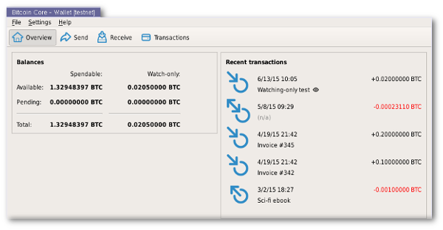
App
Concrete Arch.
No significant impacts
Bi-directional dependencies:
Everything (except Mining)
Uni-directional dependency:
Mining
Cohesive and functional system
Ensures evolution and adaptation
Logic, Functionality, Control Flow
Core logic and functionality
Primary control flow for sub-systems
Preferred currency calculation
Modular design
Pluggable features/extensions
Easier to develop & maintain
No changes
UI Components
Graphical interfaces
Displays/modifies exchange rates
Incorporate new Rates subcomponent

Slide 17
Util
Concrete Arch.
No significant impacts
Bi-directional Dependencies:
Everything
Flaw
Depends on all other components
Designed to service components
Potential of cutting corners
Sake of simplicity
Data Serialization
Serialize & deserialize data structures
Optimized for storage and transmission
Currency conversion
Network Communication
Sends & receives network messages
Handles low-level details
Value calculations for other components
Cryptographic Operations
Key generation
Signature verification
Validate exchange rates
Notes:
The Connection Manager sub-system is critical to the Bitcoin network, ensuring that all nodes can communicate with each other. The sub-system establishes and maintains connections with other peer nodes, manages the transmission and receipt of network messages, handles synchronization of the Bitcoin blockchain across nodes, and manages bandwidth usage by prioritizing network traffic and limiting established connections.
However, investigating the gaps between architectures, there were significant differences in the Connection Manager sub-system. Peer Discovery now falls under the Connection Manager, while Transactions and Blocks are stored in other sub-systems.
The Connection Manager features new dependencies. It has a bi-directional dependency with sub-systems such as Mempool, Storage Engine, App and Util while also having uni-directional dependencies with Wallet, Validation Engine, and Miner. Please note that this is summarized.

Slide 18
Risks and limitations
Security
Market data received from peers is untrusted
Must prevent malicious peers from being able to exploit vulnerabilities in Market Data Manager
Scalability
Amount of market data being sent scales more than transactions
Adding more nodes will only increase the amount of peers each node has
Higher burden on each individual node
Leverage functionality from Connection Manager and Peer Discovery to prioritize peers to communicate market data with

Slide 19
Testing
Unit testing
Integration testing
Rates unit testing should verify read/write operations in different situations
Market Data Manager unit testing should validate secure parsing and transmission of incoming data
Rates integration testing should focus on interactions with Storage Engine
Less focus on interactions with Connection Manager due to pub-sub approach
Market Data Manager interactions with Connection Manager should be tested
Market Data Manager interactions with other instances of it in other nodes in the network should also be verified

Slide 20
Use Case 1
Bitcoin Transaction

Slide 21
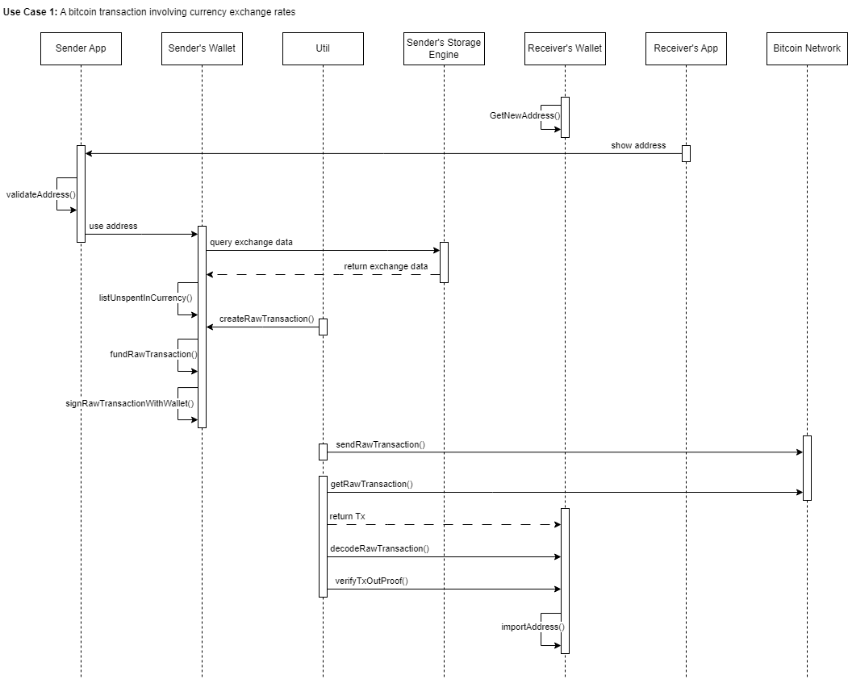

Slide 22
Use Case 2
Node Exchange Rate Update

Slide 23
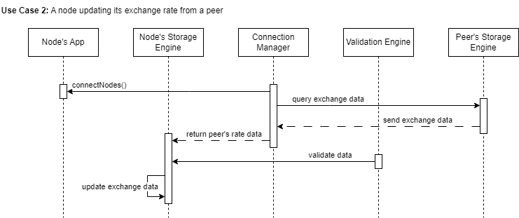

Slide 24
Lessons Learned
Modularity
Teamwork
Scope
Communication
L1
L3
Loosely coupled sub-systems
Simplicity of adding new features
Ease of maintenance
Brainstorming implementation
Drastic ideas from one another
Coming to an agreement
L2
L4
Broader implications
Scalability, security, decentralization
Significant amount of “Trial & Error”
Setting deadlines
Tracking progress
Accomplish goals

Slide 25
Conclusion
Rates Submodule
Set exchange rate:
Using UI
From Peers
NFRs:
Improved Usability!
Consistent Security

